Slide 1
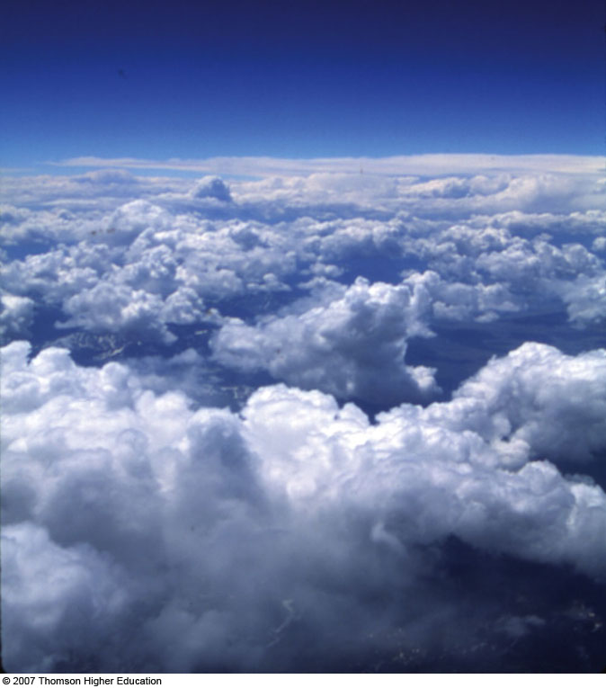
The Earth’s Atmosphere
Overview of the Earth’s atmosphere
Other planetary atmospheres
Vertical structure of the atmosphere
Weather and climate

Slide 2
Overview of the Earth’s Atmosphere
The atmosphere, when scaled to the size of an
apple, is no thicker than the skin on an apple.
The atmosphere is a gas.
The atmosphere is a fluid.
There is a surface but no “top” – the atmosphere
gradually thins out with increasing altitude

Slide 3
Composition of the Atmosphere
permanent gases
variable gases
trace gases
aerosols
roles of nitrogen, oxygen and argon
role of water vapor
carbon dioxide, methane, ozone, CFCs, et al.

Slide 4
Composition of the Atmosphere
The “dry atmosphere”: 78% N₂, 21% O₂, 1% Ar
  N₂ is primordial – it’s been part of the atmosphere as long as there’s been an atmosphere
  O₂ has been rising from none at all about 2.2 Gya – comes from photosynthesis
  Ar⁴⁰/Ar³⁶ tells us that the atmosphere has been outgassed from volcanoes

Slide 5
Composition of the Atmosphere
Water Vapor: H₂O 0-4%
  H₂0 can exist in all three phases at the surface of the Earth – solid, liquid and gas
  Liquid or solid H₂O can be suspended by atmospheric winds (clouds) or fall to the surface (precipitation)
  VERY powerful greenhouse gas (both in vapor form and as clouds)

Slide 6
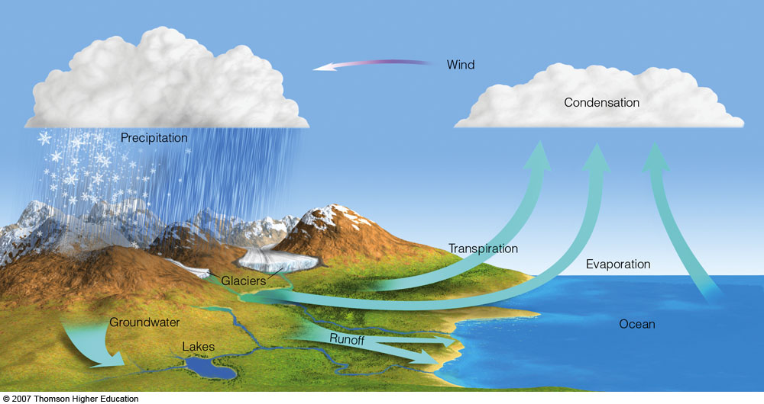
Composition of the Atmosphere
The Hydrological Cycle

Slide 7
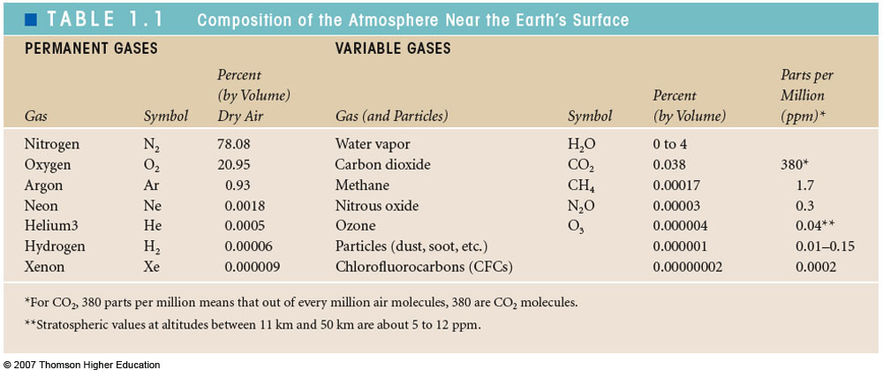
Table 1-1, p. 3

Slide 8
Composition of the Atmosphere
Carbon dioxide
  390 ppm (by mass) and counting…
  Natural and anthropogenic sources/sinks
  Strong greenhouse gas (GHG)
  CO₂ is neither the strongest atmospheric GHG pound-for-pound nor molecule-for-molecule…
  Why the fuss?
  CO₂ is a product of the reaction that allows modern civilization to exist: combustion.

Slide 9
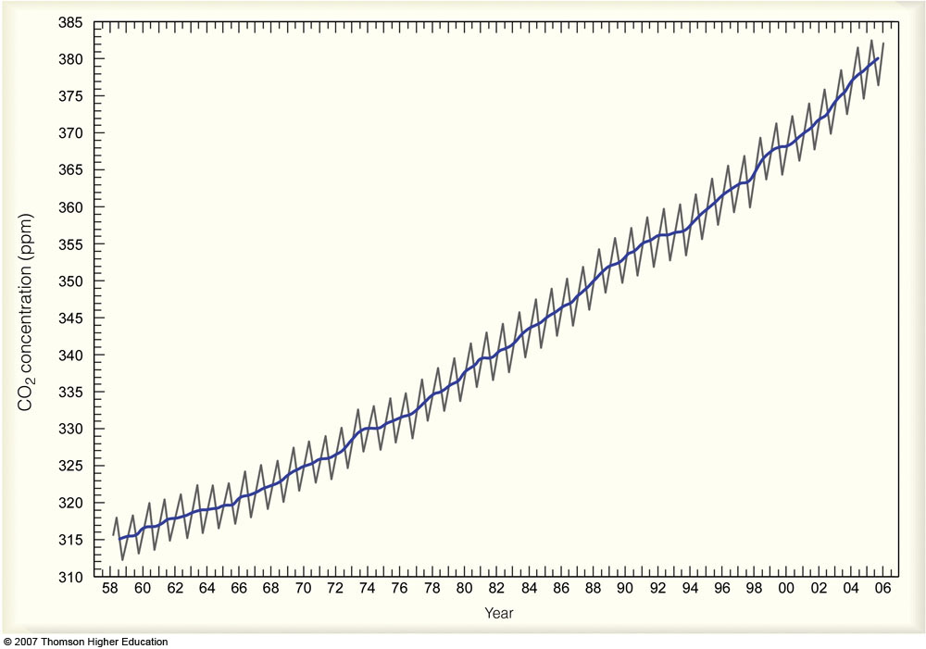
Fig. 1-4, p. 5
Notes:
Figure 1.4: Measurements of CO₂ in parts per million (ppm) at Mauna Loa Observatory, Hawaii. Higher readings occur in winter when plants die and release CO₂ to the atmosphere. Lower readings occur in summer when more abundant vegetation absorbs CO₂ from the atmosphere. The solid line is the average yearly value. Notice that the concentration of CO₂ has increased by more than 20 percent since 1958.

Slide 10
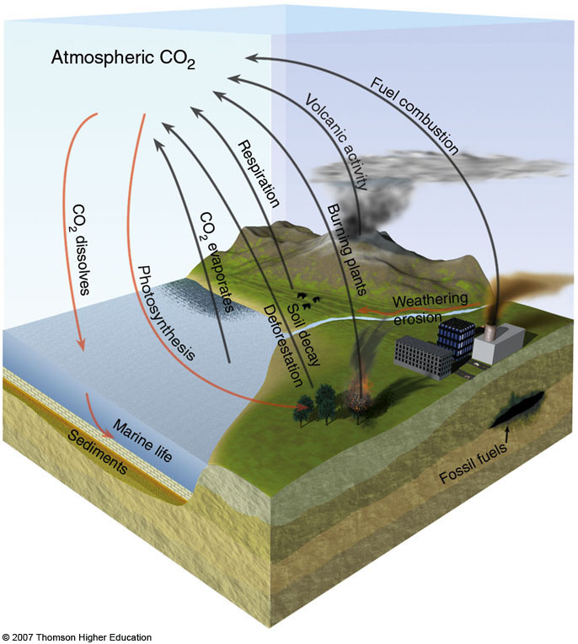
Composition of the Atmosphere
The Global Carbon Cycle

Slide 11
Composition of the Atmosphere
Methane
  CH₄ concentration: 1.8 ppmv
  anthropogenic and natural sources/sinks too
  powerful greenhouse gas
  oxidizes rapidly, hence low concentrations
  Large concentrations proposed to explain greenhouse warming of early Earth

Slide 12
Composition of the Atmosphere
Ozone, CFCs and NO_{x}
  Ozone (O₃)
    shields the surface from UV rays
    produced by reaction with NO_{x} and sunlight near the surface
  CFC’s (Chlorofluorocarbons)
    destroy stratospheric ozone
    chlorine is a catalyst: it destroys one O₃ molecule and then is free to find another
Ozone at high altitudes (stratosphere) is “good”;
ozone at low altitudes (troposphere) is “bad.”

Slide 13
Composition of the Atmosphere
Aerosols
    Dust
    Sea-spray
    Microbes
    Suspended particles in the atmosphere are responsible for cloud formation: water drops nucleate on them
    Cloud Condensation Nuclei (CCN)

Slide 14
The Early Atmosphere
reduced primitive atmosphere(H, He, CH₄, NH₃)
outgassing and the second atmosphere (N₂, Ar – still no oxygen!)
The evolution of life and the atmosphere are closely linked – life produced the oxygen (photosynthesis) and cycles the carbon (e.g. limestone)
Oxidized modern atmosphere (N₂, O₂, CO₂, etc.)

Slide 15
Other Atmospheres
YES | NO
Earth | The Moon
Mars | all the other satellites
Venus | Mercury
Jupiter | asteroids
Saturn
Uranus
Neptune
Pluto
Triton (Neptune’s moon)
Titan (Saturn’s moon)
The Sun

Slide 16
Other Atmospheres
Planet | Composition | Temperature | Pressure
Venus | CO₂ 96.5%, N₂ 3.5% | 750 K | 90000 mb
Earth | N₂ 78%, O₂ 21%, Ar 1% | 290K | 1000 mb
Mars | CO₂ 95%, N₂ 2.7%, Ar 1.6% | 220K | 10 mb

Slide 17
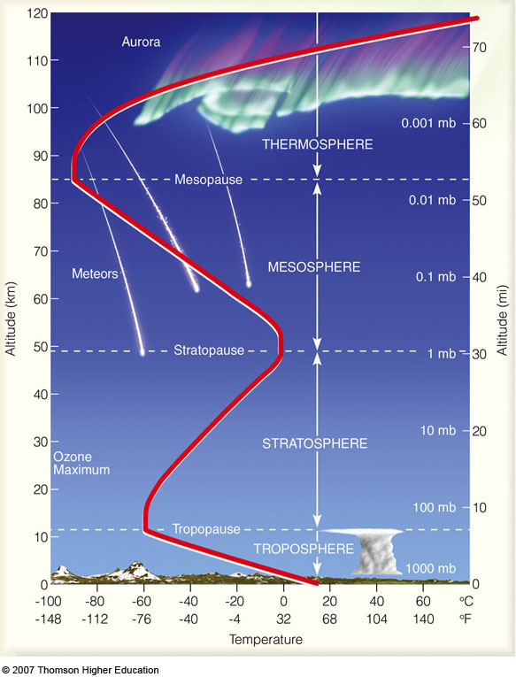
Vertical Structure of the Earth’s Atmosphere

Slide 18
A Brief Look at Air Pressure and Air Density
air density (ρ pronounced “row”)
air pressure (p)
sea-level pressure (p_{s})
Baseballs travel farther in higher-altitude air (Denver)
than they do in lower-altitude air.

Slide 19
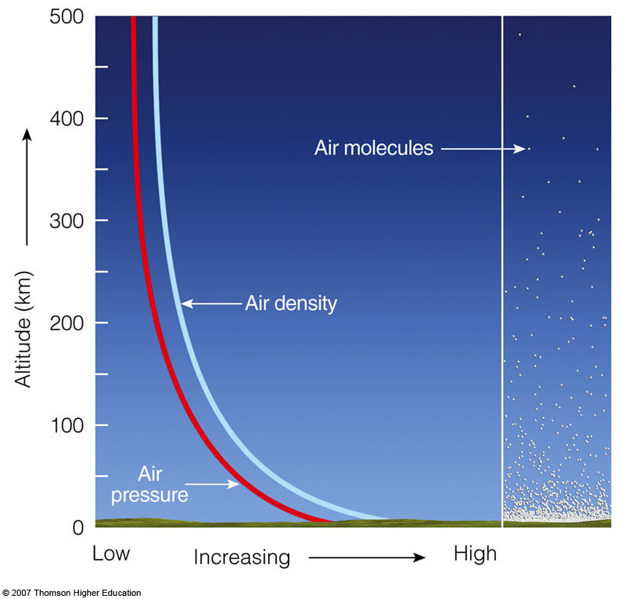
Fig. 1-7, p. 8
Notes:
Figure 1.7: Both air pressure and air density decrease with increasing altitude.

Slide 20
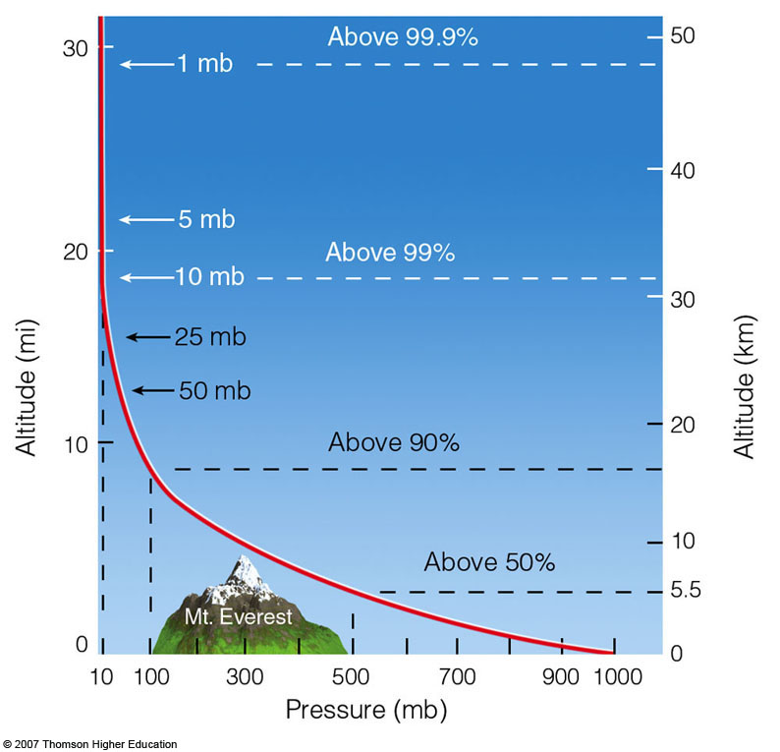
Fig. 1-8, p. 9
Notes:
Figure 1.8: Atmospheric pressure decreases rapidly with height. Climbing to an altitude of only 5.5 km, where the pressure is 500 mb, would put you above one-half of the atmosphere’s molecules.

Slide 21
Layers of the Atmosphere
vertical temperature (T) profile
troposphere
stratosphere
mesosphere
thermosphere
Temperatures, winds, humidity and pressures high above the ground are measured twice-daily by radiosonde.

Slide 22
Weather and Climate
(Chalkboard)

Slide 23
Elements of Weather
air temperature
air pressure
humidity
clouds
precipitation
visibility
wind
Certain weather elements, like
clouds, visibility and wind, are
of particular interest to pilots.

Slide 24
Climate
average weather
  time-average
  regional (spatial) average
extremes
trends

Slide 25
Weather vs. Climate
Weather is the dynamical way in which the atmosphere maintains the equilibrium climate.

Slide 26
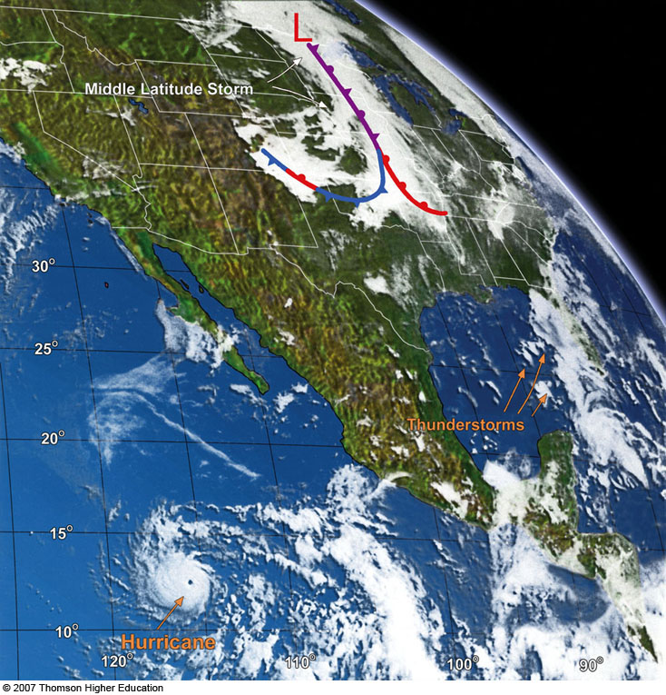
A Satellite’s View of the Weather
geostationary satellites
Atmospheric observation from satellites was an important technological development in meteorology. Other
important developments include computers, internet, and Doppler radar.

Slide 27
Storms of all Sizes
midlatitude cyclonic storms
hurricanes and tropical storms
thunderstorms
tornadoes
Storms are very exciting, but they also play an important role in moving heat and moisture around throughout the atmosphere.

Slide 28
A Look at a Weather Map
wind speed and direction
cyclones and anticyclones
fronts
Wind direction is defined in the opposite way as
ocean currents: a southerly current means water is
moving towards the south.

Slide 29
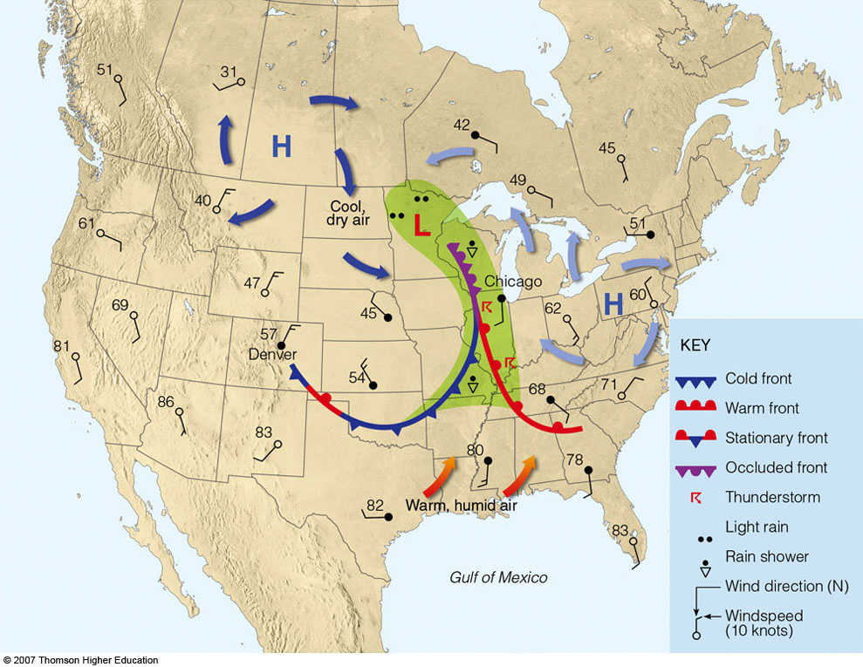
Fig. 1-13, p. 17
Notes:
Figure 1.13: Simplified surface weather map that correlates with the satellite image shown in Fig. 1.12. The shaded green area represents precipitation. The numbers on the map represent air temperatures in °F.

Slide 30
Scientific Notation
(Chalkboard)

Slide 31
Dimensional Analysis
(Chalkboard)

